Slide 1
Successful IT-projects: The role of the contract
Magne Jørgensen
Simula Research Laboratory

Slide 2
Presentation based on:
Jørgensen, Magne. "A Survey on the Characteristics of Projects with Success in Delivering Client Benefits.” Information and Software Technology 78 (2016), 83-94
Jørgensen, Magne. "Failure factors of small software projects at a global outsourcing marketplace." Journal of Systems and Software 92 (2014): 157-169.
Jørgensen, Magne. "A strong focus on low price when selecting software providers increases the likelihood of failure in software outsourcing projects." Proceedings of the 17th International Conference on Evaluation and Assessment in Software Engineering. ACM, 2013.
Jørgensen, Magne. "The influence of selection bias on effort overruns in software development projects." Information and Software Technology 55.9 (2013): 1640-1650.
Jørgensen, M., & Grimstad, S. (2005, February). Over-Optimism in Software Development Projects:" The Winner’s Curse". In Electronics, Communications and Computers, 2005. CONIELECOMP 2005. Proceedings. 15th International Conference on (pp. 280-285). IEEE.
Download publications: www.simula.no/people/magnej

Slide 3
The datasets
Three questionnaire-based surveys about IT-projects and contracts
Number of responses between 60 and 150 per survey.
Interview-based, in-depth study of 35 IT-projects of 11 public organizations
Analysis of more than 400.000 small IT-projects (from an internet outsourcing/offshoring marketplace)

Slide 4
A short survey (5 min)
tinyurl.com/contract29

Slide 5
How successful were the IT-projects we studied?

Slide 6
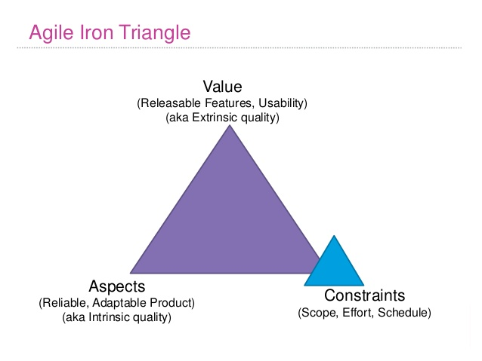
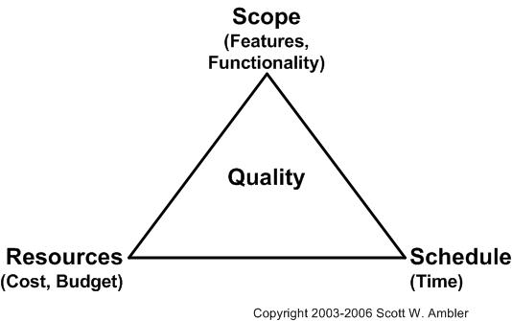
It all depends on the definition of success
Success is context dependent and often a prioritized combination of:
Client benefits (goal achievement, profit, ROI)
Functionality delivered
Technical quality of the system
Cost control
Time control
Efficicency/productivity of the project

Slide 7
Most IT projects are ok (at least among those we studied)
The questionnaire-based surveys:
Slightly more than 50% of the project were (self-)evaluated as “acceptable” or better on the criteria: benefits, functionality, quality, cost, time and productivity
No big difference dependent on whether the client was public or private
This as opposed to a study we did in 2004, where the project with public client did much worse
The interview-based study:
About 70% of the projects delivered the expected benefits and had no major problems on the other success dimensions
About 30% had major problems on at least one of the success dimensions.
Analysis of outsourcing data:
14% of the projects failed, meaning that they were either cancelled or the client evaluated the provider deliveries as “poor” or worse.
The failure rates, applying this definition, of the questionnaire and interview-based studies were about 5-10%.
Notes:
NB: Ikke nødvendigvis representativt utvalg

Slide 8
How does the contract type affect IT project success?

Slide 9
Results from the first, questionnaire-based, study

Slide 10
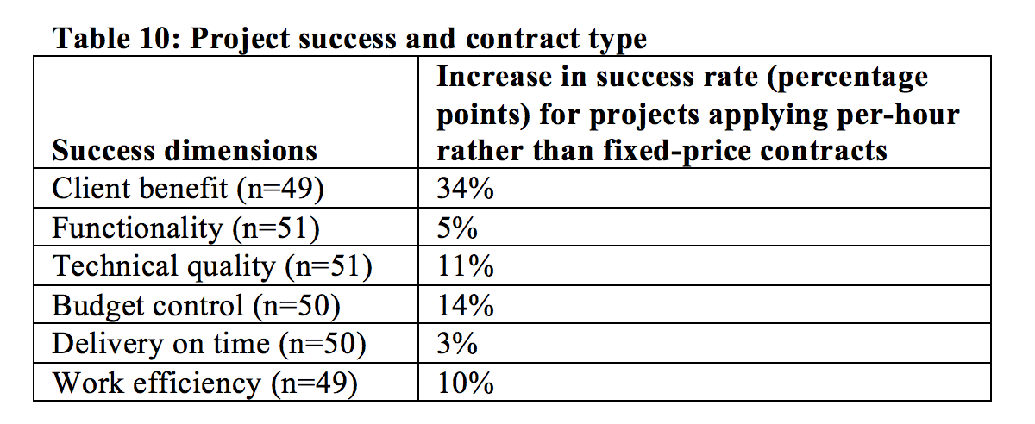
Large difference in success rate! (success = “very successful” or “successful”)
Success dimension | Fixed price contracts | Per hour contracts | ”Agile” contracts | Risk sharing contracts
Client benefit | 0% | 59% | 29% | 22%
Quality | 22% | 24% | 43% | 22%
Budget control | 33% | 31% | 71% | 22%
Time control | 11% | 29% | 43% | 44%
Efficiency | 0% | 19% | 29% | 33%
Proportion contract | 18% | 37% | 14% | 41%
Categorizing agile contract as per hour and risk sharing as fixed price, the picture get even clearer.

Slide 11
Results from the outsourcing study
Binary, logistic regression with outcome variable values ”failure” (1) and ”non-failure” (0)

Slide 12
Fixed price contract-based IT-projects did much worse than those with ”per hour” payment

Slide 13
The in-depth, interview-based study (where we examined how the contract were actually used)

Slide 14
Actual contract type and success rate
Success: Deliver the expected client benefits and no major problems on the other success dimensions.
Actual contract type | Success rate
Per hour | 79%
Fixed price | 40%
Per hour contract: Either pure hourly contract, agile contracts or ”target price” (risk sharing) that were managed similarly to an hourly contract, e.g., no upper limit for risk sharing or very flexible scope (but still with target price and upper limit).
Fixed price contract: Either a pure fixed price contract or ”target price” managed similarly to a fixed price contract, e.g., with upper limit for risk sharing.
Notes:
Et eksempel på målpris uten tak som likevel ble oppfattet som fastpris er SPK-Min side medlem (Men scope ser ut til å være fleksibelt). Senere i prosjektet gått over til ren per time.
Parastoo: Flere starter med målpris eller fastpris og går over til per-time etter hvert. “Tillit” nevnes å være avgjørende her.

Slide 15
Why did fixed price project perform so badly, especially regarding client benefits?
Winner’s curse?
Fixed price behavior?
Lower involvement by client?
Selection of less competent providers?
Fixed price more frequently selected by less competent clients?
Other explanations?

Slide 16
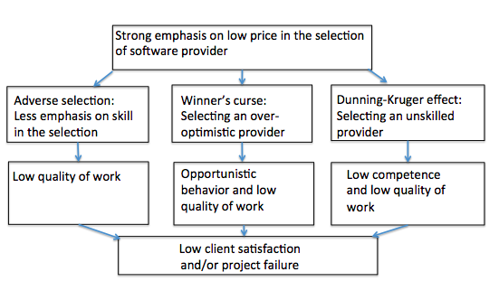
Fixed price contracts are typically connected with a stronger focus on low price when selecting providers
Notes:
Fixed price behavior = Opportunistic behavior

Slide 17
Results from the outsourcing study
Selection of provider with (fixed price) bid less than 25% of the average bid led to a 9% increase in project failure for the same level of provider competence.
Odds ratio (failure) of High vs Low focus on price was 0.84
This means that most low price focused half of the clients had 16% higher risk of failure (after adjusting for other differences) compared to the others.

Slide 18
Modelling the size of the winner’s curse:
Variance shrinkage (includes the effect of different degree of “public value” and provider skill)
Uncertainty
Focus on low price (includes the effect of number of bidders)
M. Jørgensen. The Influence of Selection Bias on Effort Overruns in Software Development Projects, Information and Software Technology 55(9):1640-1650, 2013.
Notes:
Expected decrease in height when r=0.5 shrinkage is 1 and w = 1.04: (1-0.5*1)(1-1.04), which implies 2 cm lower than me and my wife, expressed as mid-parent (+ 7 cm because boy) = cxpected height is 173+7-3 = 177 cm. Av mid-parent height = (179 + 168)/2 = 173, Actual mid-parent height = (192 + 168)/2 = 180

Slide 19
The in-depth, interview-based study: Adverse selection and fixed price behavior
Adverse selection: Fixed price contracts were most common when the knowledge about provider competence was low (new system, new provider) and the evaluation of provider skill was relatively poor.
Fixed-price behaviour (especially when over-optimistic price):
Every change in the requirements required much administration and (often complex) discussion about payment
The providers (and the clients!) got less benefit-oriented and more contract/requirement specification-oriented
The providers were more likely to behave ”opportunistically” (= low quality)
Project problems, such as time and cost overruns, were more likely to escalate, abort the project and end up in court

Slide 20
A questionnaire-based survey on projects with “target price”/risk sharing illustrated the effect of providers (risking) losing money
Hypothesis of study: There is a difference in provider behavior and project success dependent on whether the risk sharing-based contract has an upper limit (typically at 30% overrun) for risk sharing or not.
Responses from 60 software professionals with experience from at least one (many of them with both) variants of risk sharing
Responses based on their last projects using the target price contract variants:
33% of the projects with upper limit for risk sharing and 83% of the project without upper limit for risk sharing had been successful with regards to client benefits.
90% had experienced that target price with upper limit led to more focus on the specification and less on client benefits compared with the same contract without upper limit (91% had experienced this with fixed price compared to per hour contracts).
Notes:
Parastoo: Fastpris kontrakter fører til mye diskusjoner mellom kunde og leverandør; ofte på trivielle ting. Posten (Meldingsformidling)

Slide 21
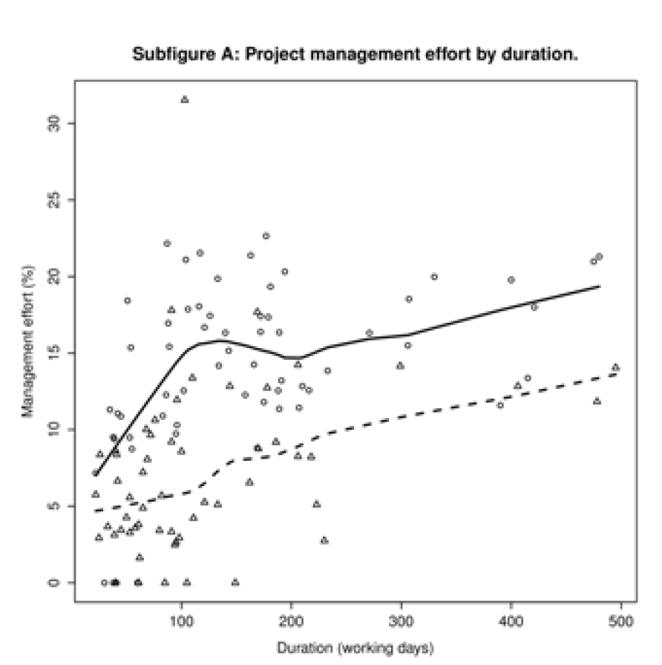
Fixed price requires more administration Ahonen, Jarmo J., et al. "Reported project management effort, project size, and contract type." Journal of Systems and Software 109 (2015): 205-213.
Fixed price
Per hour

Slide 22
And fixed-price contracts do not even ensure a fixed price
Abhijit V. Banerjee and Esther Duflo
Reputation Effects and the Limits of Contracting: A Study of the Indian Software Industry
The Quarterly Journal of Economics (2000) 115 (3): 989-1017
The study also document that the cost overruns are about twice as large in fixed price projects, even after adjusting for difference in size and type.

Slide 23
The contract type is a central part of the “success patterns” of IT-projects

Slide 24
The successful hourly paid project
The choice of contracts based on payment per hour (or “agile”) typically goes together with (correlate with or cause) more success and:
Selection of providers based on evaluation of their competence and not so much on low price
Competent and involved clients who has a strong hand on selecting and managing provider resources (as opposed to “give” the project to a provider and let them decide who is going to work on the project)
Flexible scope
Good benefit management processes (in particular benefit management during the project execution)
Agile development with frequent deliveries (to production or at least evaluated by real users)
Early involvement of stakeholders and users
The use of fixed price contracts is not in direct opposition to any of these factors. In practice, however, there are several fixed price elements that works against it.

Slide 25
Fixed price contracts may create problems because they
Makes the price more natural as a selection criterion, on the cost of emphasis of provider competence, e.g., when you need a good argumentation not to select among those with lowest price.
Gives less mature (less competent) clients a feeling of lower financial risk based on the false belief that ”fixed price = risk is on the provider” and ”per hour = risk is on the client”.
Makes flexible scope and benefit management during the project execution more difficult.
“Scope creep” (fixed price) vs “Embrace change” (per hour payment).
Makes it more natural to think about the project delivery as one big chunk, and not incrementally delivery of client benefits (including benefits not even known in the planning phase).

Slide 26
No place for fixed price contracts?
Seems to work fine (few examples) as part of agile contracts, where the price is fixed for small, well understood deliveries completed in sequence.
Mixed contracts, where the main part is paid per hour and only the low uncertainty parts have fixed price.
NB: My results are about IT-development, not about IT support, IT infrastructure, etc.

